Slide 1
Figure S1. Effect of 37-mer peptide treatment on HeLa cells over 24 h. (A) Data showed negligible effect on cell viability with an increase in ACP concentration (“*” denotes P<0.01, “**” denotes P<0.001, n=3). (B) Treatment of HeLa cells with 121.5 µM. Untreated cells formed compact circular condensed attached cells. Peptide treatment caused cell morphology to become more rounded, sparse, and detach from the plate. Highlighted circle regions showed rounded dead cells releasing cellular vacuoles. Cell images are processed at magnification scale of 50 µm.

Slide 2
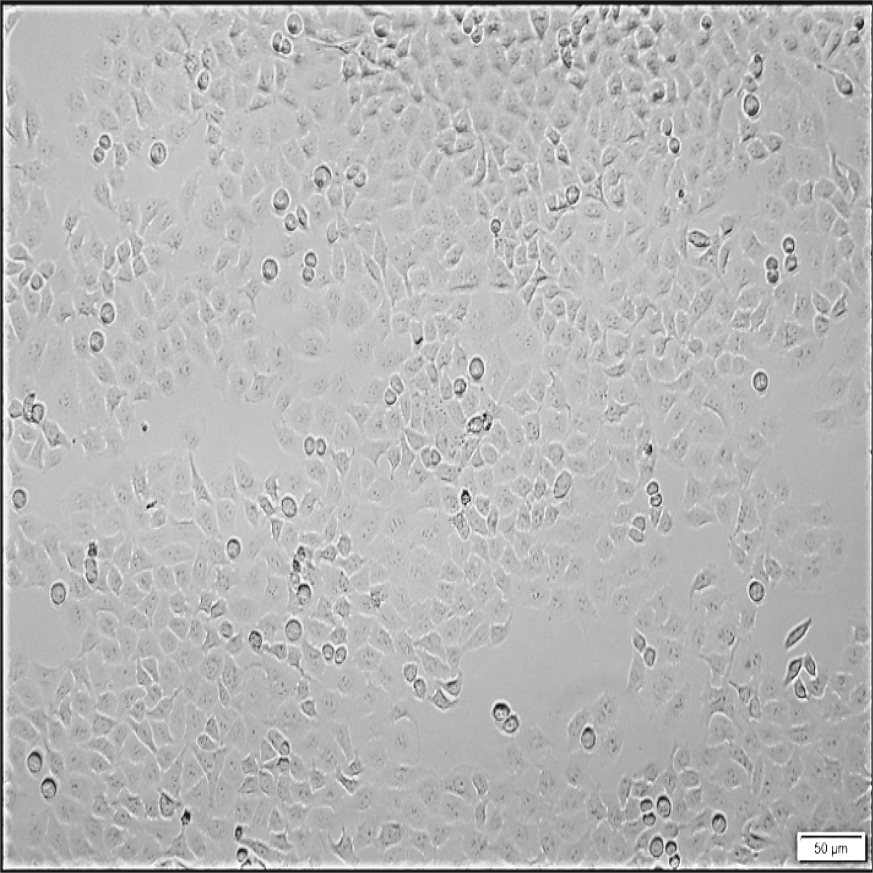
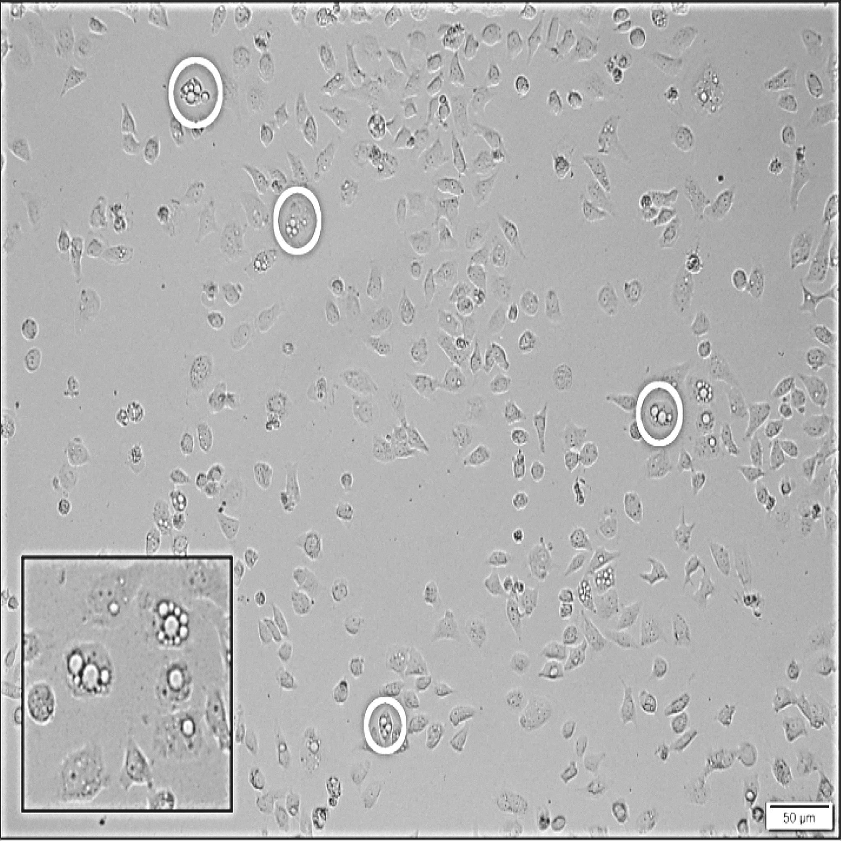
Untreated
37-mer peptide (121.5 µM)
(A)
HeLa
(24 h)
(B)

