Slide 1
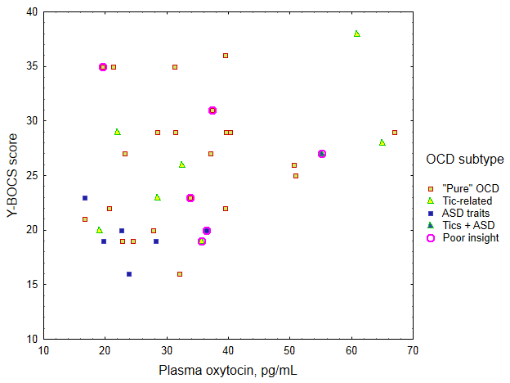
Supplemental figure: Correlation between baseline plasma oxytocin and baseline severity of OCD, according to OCD subtypes

