Slide 1
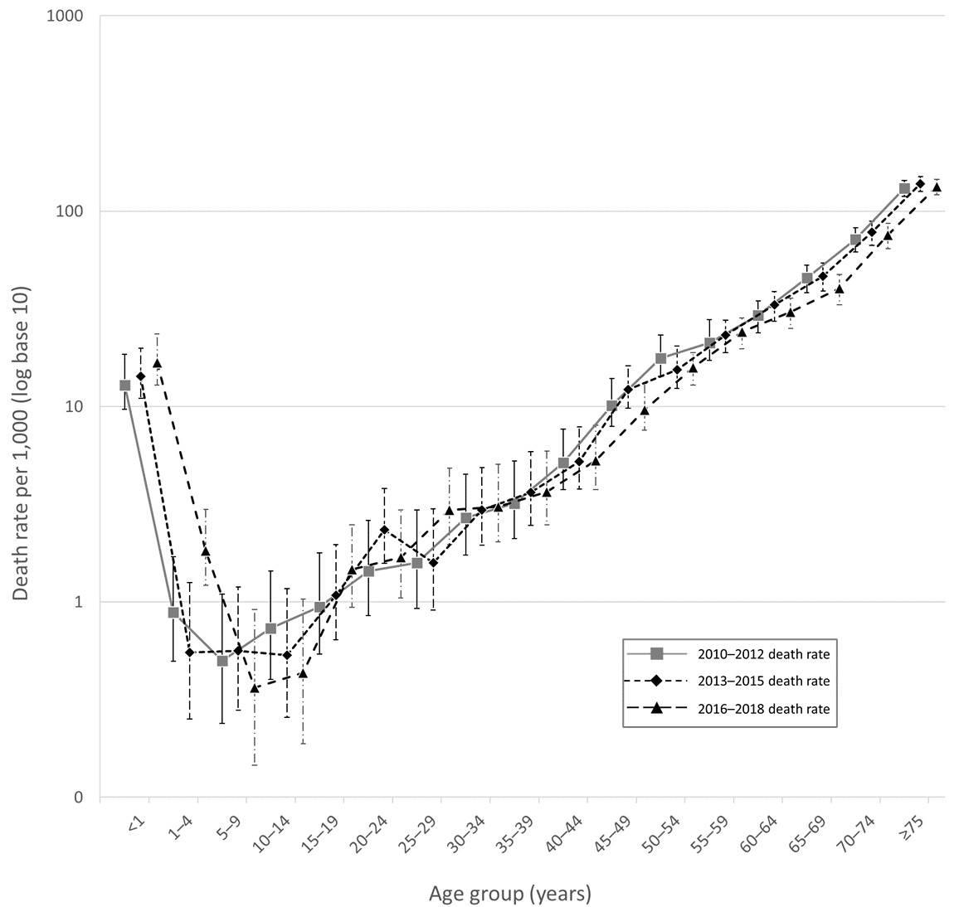
Notes:
Fig. S1. Logarithmic graph of male age-specific death rates per 1,000, Tonga, by triennia, 2010-2018

