Slide 1
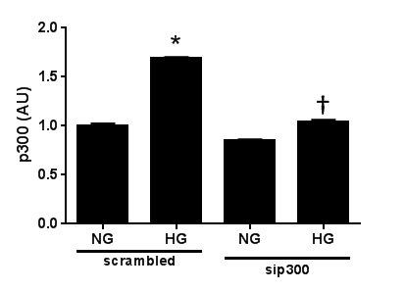
a
scrambled
sip300
b
NG
HG
NG
HG
IB: p300
IB: GAPDH
c
Curcumin
NG HG Man
NG HG Man
IB: P-Smad2
IB: Smad2/3
Supplementary Figure 1

