Slide 1
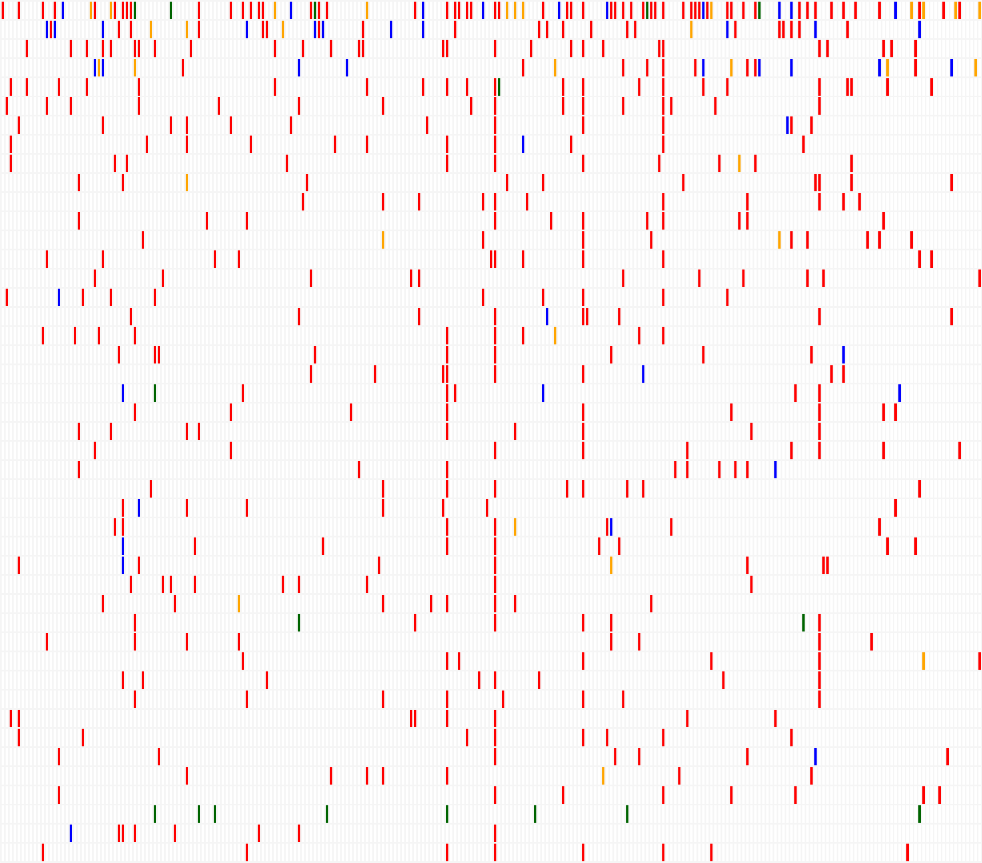
Figure S4
A
B
2
1
0
CSPG4 mRNA
(log2-ratio)
-1
-2
CSPG4-low
CSPG4-high
Frequency (%)
Frequency (%)
0%
10%
20%
30%
40%
0%
10%
20%
30%
40%
TP53
ATRX
TTN
q=1
RB1
MUC16
PCLO
USH2A
MUC17
DH5
SCN2A
GPR98
CSMD1
LRP2
RYR1
MT-CO1
FAT3
OBSCN
RYR2
global
CSPG4-low
AHK
CSPG4-high
PKHD1L1
NF1
LRP1B
DCC
DCHS2
MT-CO2
APOB
SPHKAP
MACF1
DH9
HYDIN
PEG3
q=1
DH8
TNRC18
SYNE1
DH7
FAT1
TMEM132C
FLG
ZNF831
MUC4
SCN9A
FREM2
NUMBL
AHK2
q=1
MUC5B
Frame-shift
p<5%
SNP
0.0
0.5
1.0
1.5
2.0
Deletion
p-value (-log10)
Insertion
Splice
Fisher’s exact test

