Slide 1
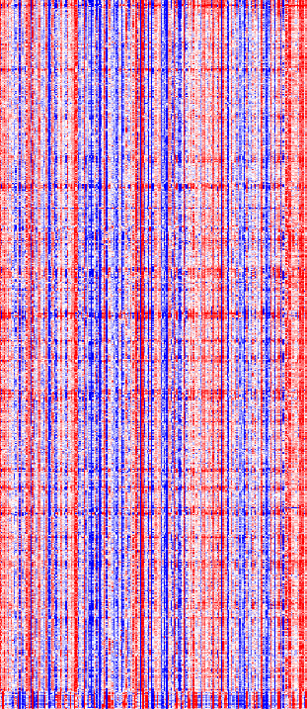
Figure S5
A
B
2
CSPG4
high vs. low
1
CSPG4 mRNA
(log2-ratio)
0
-1
-2
CSPG4-low
CSPG4-high
q-value (-log10)
0
2
4
6
8
10
chr 1
chr 3
chr 5
chr 7
chr 9
chr 11
chr 13
chr 15
chr 17
chr 19
chr 21
chr X
scale
Student, t-test
<-2
0
>2

