Slide 1
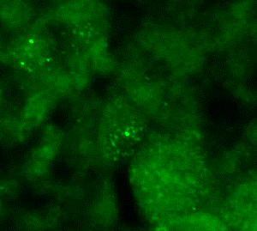
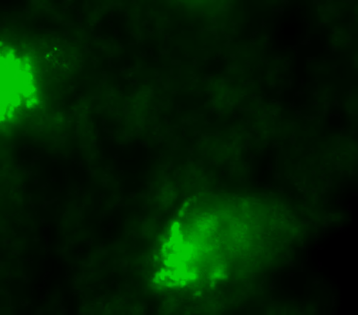
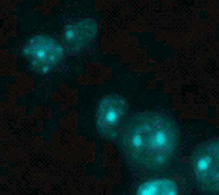
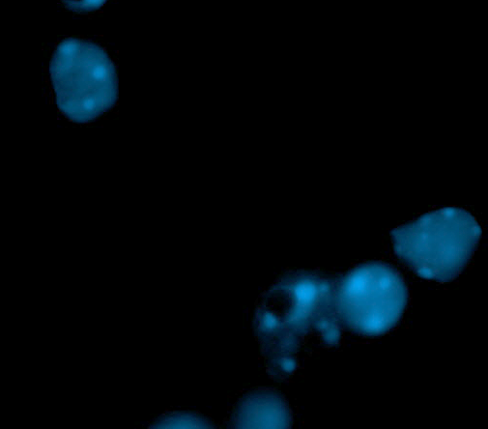
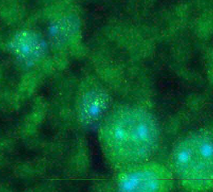
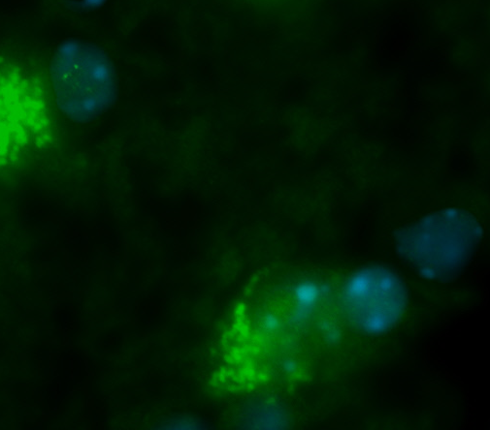
Figure S2.
8-week-old (spinal cord)
2-y-old (spinal cord)
NEAT1_1
NEAT1_1
*
*
Hoechst
Hoechst
NEAT1_1
/Hoechst
NEAT1_1
/Hoechst
*
*

