Slide 1
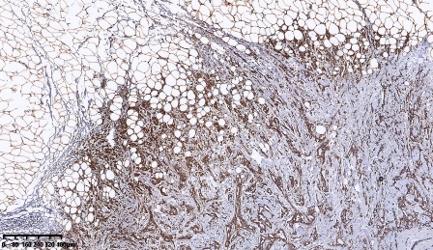
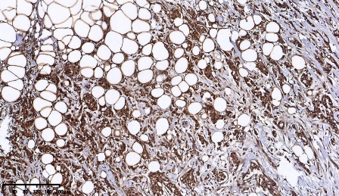
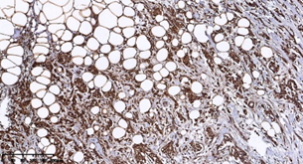
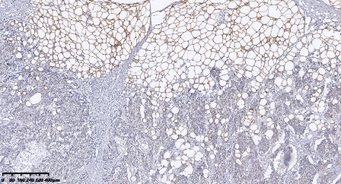
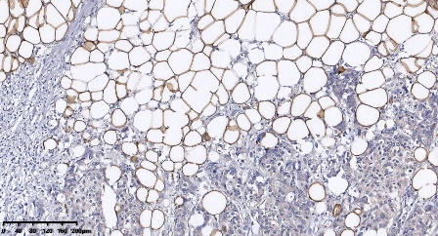
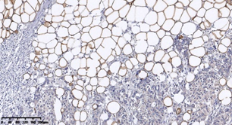
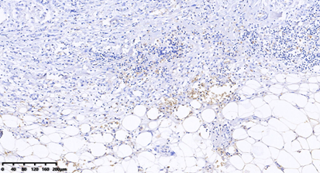
AD
Perilipin A
IF
C
Perilipin A
FABP4
Figure S1: The expression of Perilipin A and FAPB4 in invasive front of breast cancer. (A) Representative immunohistochemistry staining of Perilipin A and FAPB4. The pictures showed the negative staining of FABP4 and the positive staining of Perilipin A in stromal adipocytes located to breast cancer tissues. Ad, adipose tissue; IF, invasive front; C, tumor center.

Slide 2
A
C
B
D
Figure S2: miRNA expression in exosomes and tumor cells. (A) MCF-7 cells were cocultivated in the presence or absence of adipocytes. After 3 days, exosomal miRNAs except miRNA-144 and miRNA-126 were further verified by qPCR. (B) The levels of miRNAs expression in different breast cancer cells were obtained from UCSC. (C) miRNA-126 expression levels in exosomes from CA-CM treated with GW4869 (final concentration, 10μM), an inhibitor of the exosome secretion from cells. (D) Adipocytes were cocultivated in the presence or absence of MDA-MB-231cells. After 3 days, RNA was extracted from the adipocytes and subjected to qPCR analysis with primers specific to Mature-miRNA-155 and Pre-miRNA-155. The data shown are mean values ± S.D. derived from at least three independent experiments. * P < 0.05 versus control values.

Slide 3
Figure S3: The level of CCL5 in the supernatants of adipocytes increased in the presence of breast tumor cells. The secretion levels of CCL5 enriched in media were determined by ELISA assay. AD: adipocytes. The adipocytes in CytoD group receive Cytochalasin D (final concentration, 2 μg/ml) and 20 mg exosomes purified from cancer-associated adipocytes conditioned medium (CA-CM).

Slide 4
*
*
- MDA-MB-231
Figure S4: Representative experiments of transmission electron microscopy highlighting mitochondrial ultra-structural changes (*) in adipocytes or adipocytes cultivated with MDA-MB-231. Scale bars: 1 μm.

