Slide 1
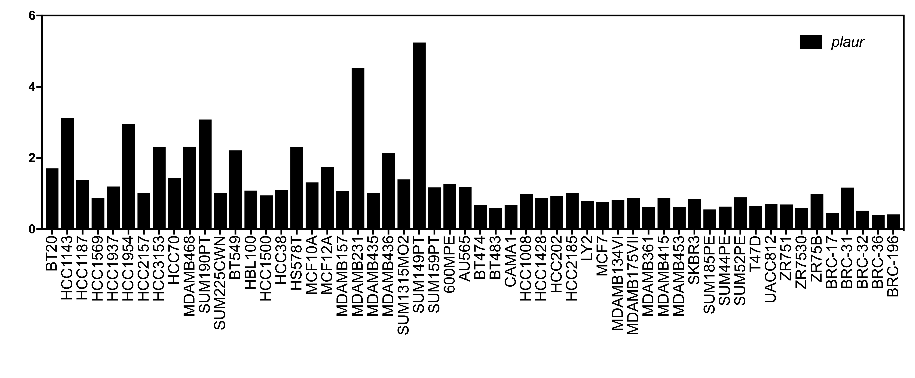
Affymetrix Expression
Arbitrary units
Basal B
Basal A
Basal B
Luminal
Lum
Annis et al., Additional File: Fig. S4

