Slide 1
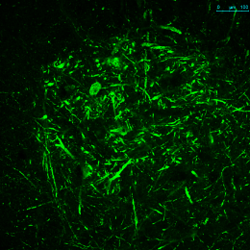
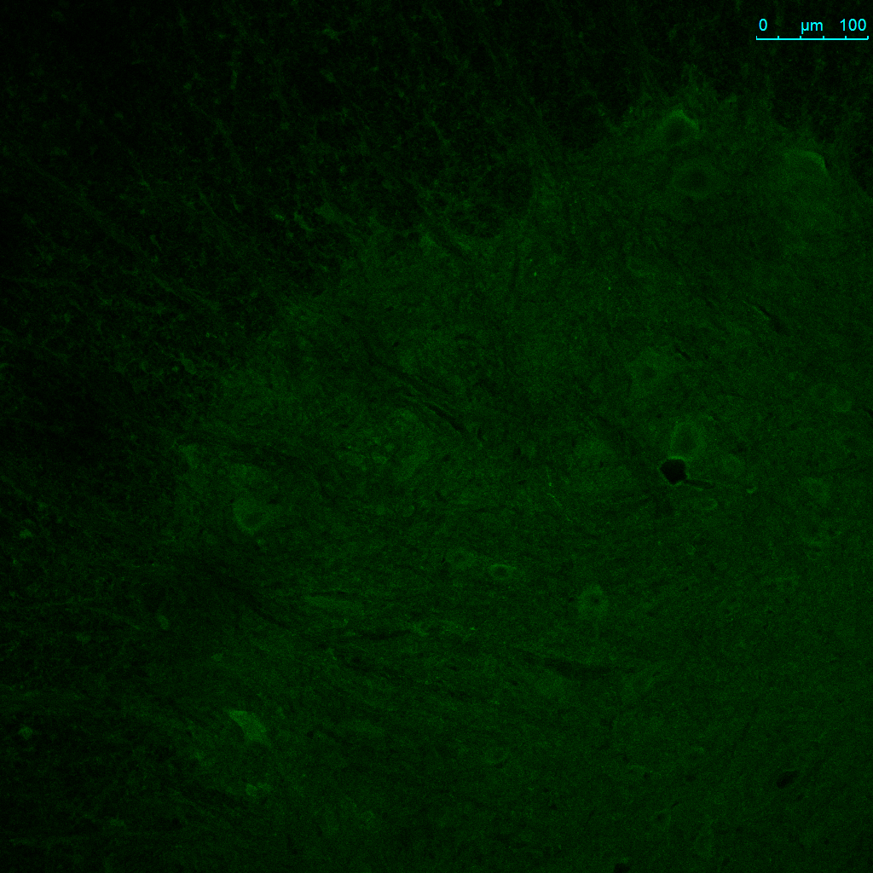
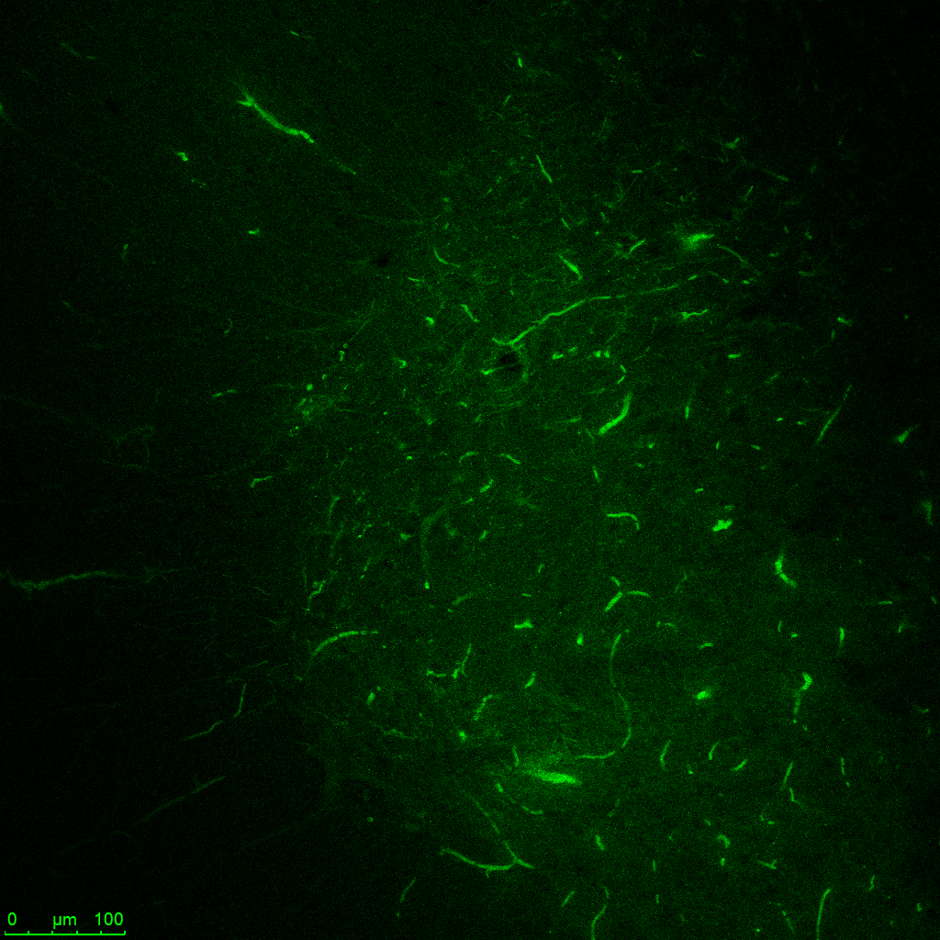
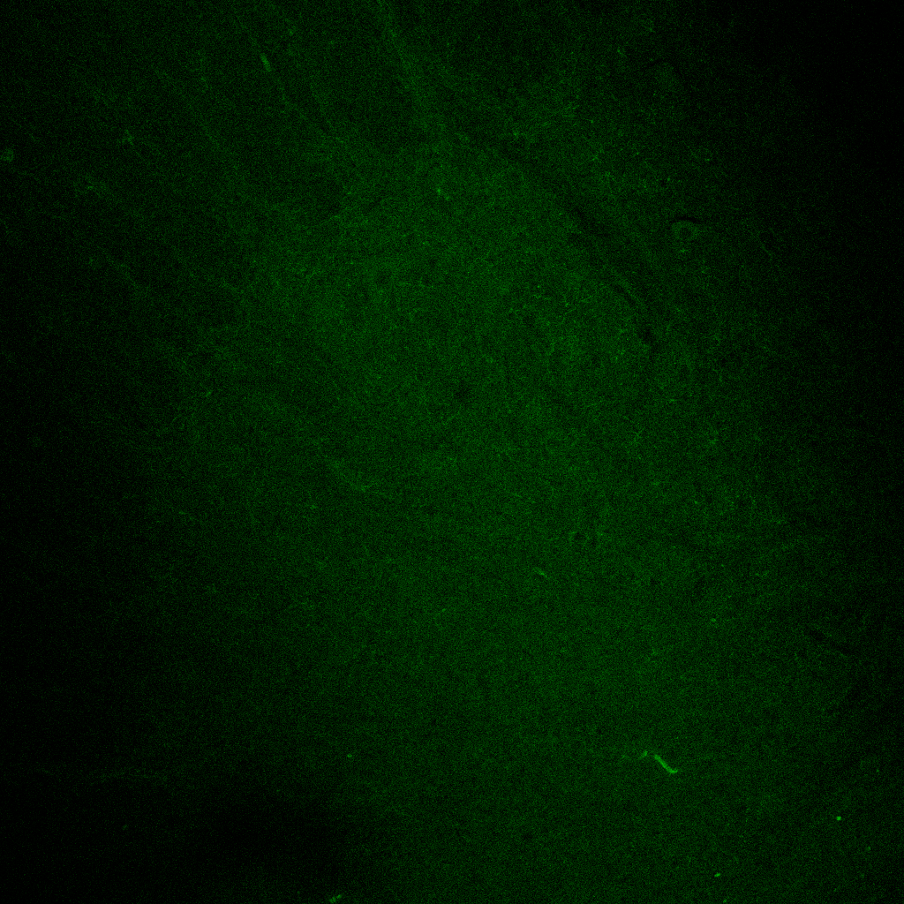
A
SOD1^{WT}
SOD1^{G93A}
SOD1^{WT}
B
IgG mouse
IgG rabbit
secondary
A5C3
B8H10
C4F6
D3H5
DSE2
AMF7-63
SEDI
Pickles et al. Figure S1
Notes:
Add Scale bar 100 uM. Put in SEDI

